Slide 1
2023 Function & Event Packages

Slide 2
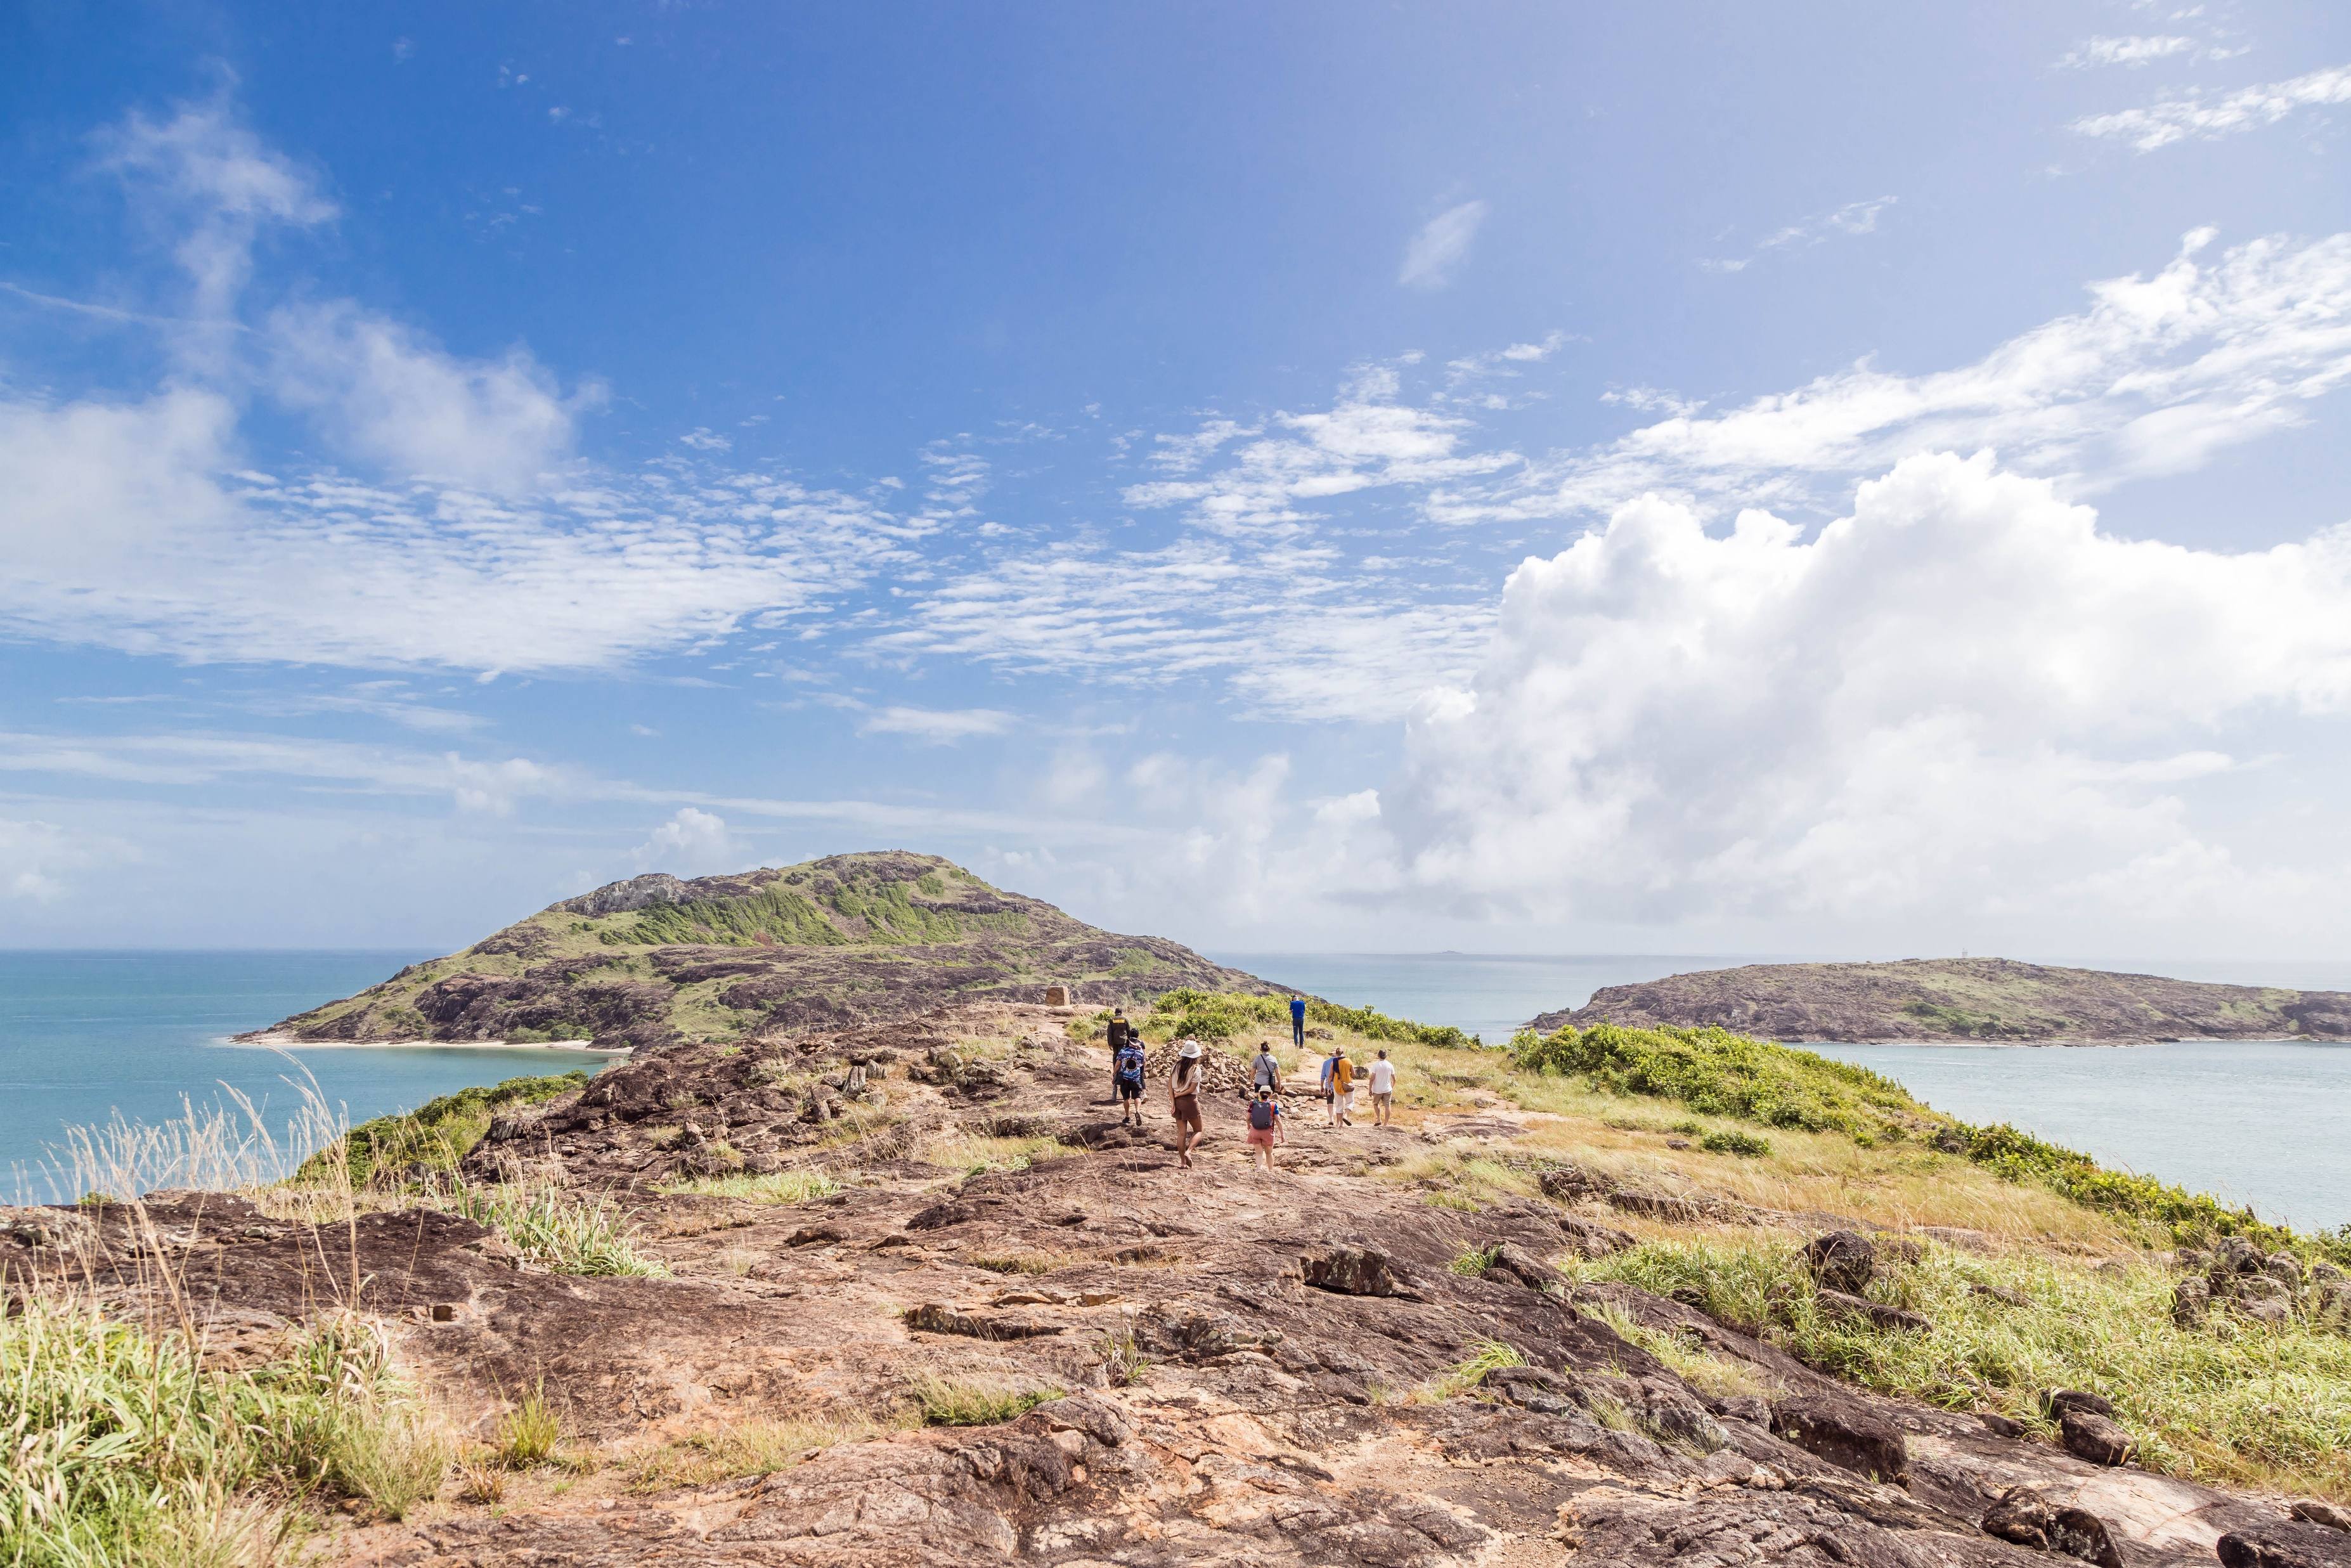
Welcome to the Top of Australia
Cape York Peninsula Lodge is a destination you will never forget. With its stunning scenery and natural environments, fascinating history and enduring Indigenous cultures, exploring the wilderness of Cape York Peninsula is a life enhancing experience.
The Lodge is the perfect choice for your next event, with our equipped boardroom that can cater to a business meeting or seamlessly expand out into the restaurant to comfortably cater up to 130 people. The restaurant sprawls out onto our undercover deck that overlooks the pool area and stage with lawn space for events.

Slide 3
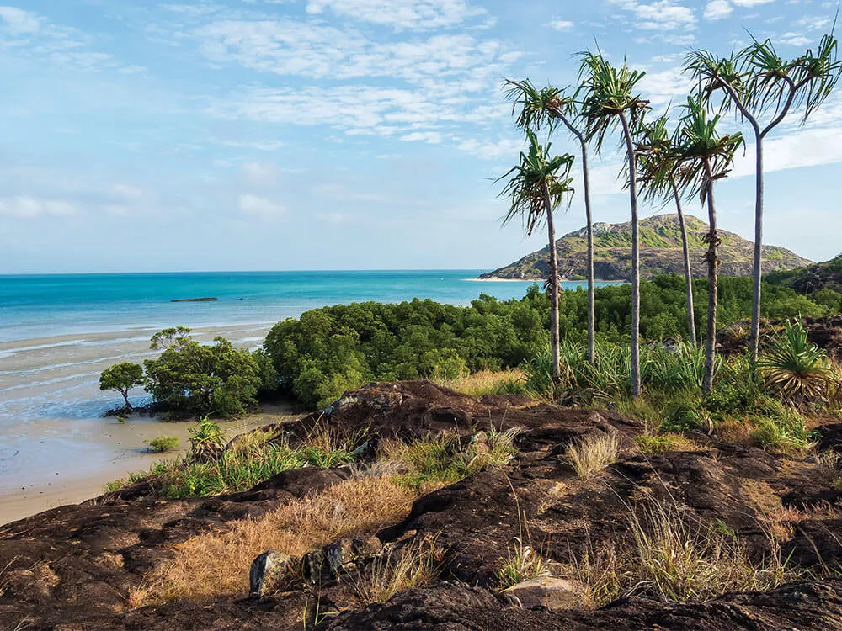
Location
Facilities
Situated at the Top of Australia in Cape York, our Resort is set in the middle of one of the local communities Bamaga. It is only a 10min drive to the beachfront and 10min from our local airport.
Corner Lui & Adidi Streets Bamaga, Queensland 4876
The Lodge is made up of 41 guest, suitable for all budgets, with all rooms featuring an ensuite & private balcony. In addition Bamaga Motel which has 15 rooms is managed by CYPL.
Guests also have access to the following facilities.
Reception 8am-4pm
Onsite Paperbark Restaurant & Bar
Hire Cars- 2wd & 4wd
Cultural Tours
Onsite Secure Carpark
Transfers
Swimming Pool with covered seating area
Modern Conference Room
Local Attractions
The Top of Australia Tour (Pajinka)
The Falls Tour
5 local communities (Bamaga, Seisia, Injinoo, New Mapoon & Umagico)
Traditional Dance Group

Slide 4
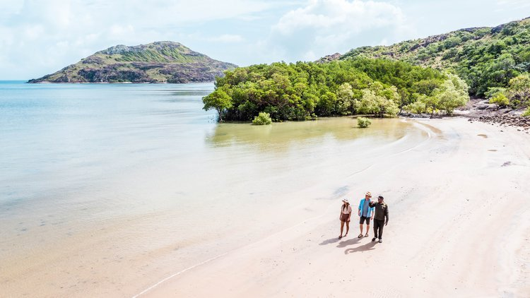
Hire Fees
Board Room
Our Boardroom is available for hire at a price of $200.00 for a half day and $350.00 for a full day.
Inclusive in this rate is the usage of all audiovisual equipment and materials.
Paperbark Restaurant
Our Restaurant is available for private use as long as the selected date does not clash with the requirements of our in-house guests. There will be a hire fee of $350.00 for the restaurant.
This is a minimum of 40 people to hire out the venue and 130 people maximum.
Cape York Peninsula Lodge is not licenced for off site catering

Slide 5
Breakfast Options
Hot Buffet Breakfast $30pp (20pax min)
Crispy Bacon Rashers
Grilled Breakfast Sausages
Slow Roasted Tomato with Fine Herbs
Confit Field Mushrooms
Hash Brown
Scrambled Eggs
Orange Juice, tropical Juice or Apple Juice
Freshly Brewed Vittoria Coffee & LMVT Fine Leaf Tea
Continental Breakfast $22.50pp (20pax min)
House made Muffins
Mini Croissants
Assorted Breakfast Cereals
Yoghurts
Seasonal Fruit Salad
Selection of Toast Bread
Assorted Condiments
Orange Juice, tropical Juice or Apple Juice
Freshly Brewed Vittoria Coffee & LMVT Fine Leaf Tea

Slide 6
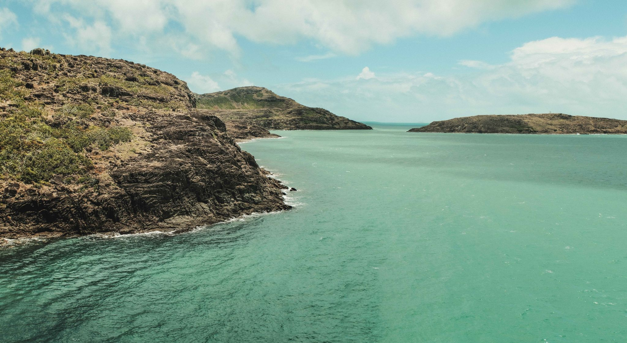
Morning & Afternoon Tea Options
Savoury
Mini Croissants with Sliced Leg Ham, Tomato & Cheese $5.00pp
Vegetarian Frittata (GF) (VT) $5.00pp
Bacon & Egg Roll with BBQ Sauce- Option of Gluten Free $7.5opp
Sweet
House Made Scones with Jam & Whipped Cream $5.00pp
Seasonal Fruit Skewer (GF) (VT) (VG) $5.00pp
Banana Bread with Honeyed Whipped Cream $5.00pp
Portuguese Custard Tart $5.50pp
Large Muffin $6.50pp
Optional Beverages
Mixed juice Selection $4.50pp
Freshly Brewed Vittoria Coffee & LMVT Fine Leaf Tea Selection $4.00pp
Assorted Soft Drinks $4.50pp

Slide 7
Lunch Options
Boardroom Luncheons
Please choose one of the following luncheon options.
Platter Lunch $10.00pp- 1 x wrap or roll per person
Chef’s Bakery Selection of Wraps & Rolls - Option of Gluten Free
Hot Lunch $30.00pp (20 pax min)
Grilled Rump Steak with Chips & Gravy (GF)
Beer Battered Snapper with Chips, Salad & Dill Tartar
Pumpkin Ravioli or Coconut Jack Fruit Stir Fry (VG) (GF)
Optional Beverages
Mixed Juice Selection $4.50pp
Assorted Soft Drinks $4.50pp

Slide 8
Buffet Options minimum of 20 people
Roast Buffet $35 per adult/$15.00 per child under 15
Buffet Option Number 3
$50 per adult/ $25 per child under 15
Choice of two meats:
Beef, Pork or Lamb Roast potatoes Roasted vegetables
Steamed Rice
Bread Rolls
Green Salad & Coleslaw Salad
Steamed Rice
Striploin Steak – Gravy
Grilled Swordfish- lemon & Caper Butter
Garlic Prawns
Moroccan Chicken
Steamed Mix Vegetables & Chips
Green Salad & Coleslaw Salad
Bread Rolls
Buffet Option Number 2
$40 per adult/ $20 per child under 15
Desserts ( additional cost)
Steamed Rice
Rump Steak - Gravy
Battered Snapper
Chicken Tortelini Carbonara
Spicy Squid Tentacles
Steamed Mixed Vegetables & Chips
Green Salad & Coleslaw Salad
Bread Rolls
Trio of Ice Cream or Sorbet - additional $12pp
Chefs’ Cheesecake or Hot Dessert - additional $14pp
Kids ice cream is free

Slide 9
Terms & Conditions
All quoted prices include food preparation and service, staffing (front & back of house), all kitchen equipment, glassware and napery components. These prices are G.S.T. inclusive.
Final attendance numbers must be advised at least 7 days prior to the commencement of the any function. This is the minimum number of guests that will be invoiced to the client.
In the event of a late increase in numbers, our catering team will endeavour to cater additional guests. Given the remoteness of our location however, this may not be possible. The onus to provide an accurate catering number rests with the client.
Cape York Peninsula Lodge requires a holding deposit of 25% of the projected revenue of the function on acceptance of the confirmation. In the unfortunate event of a cancellation of the function this deposit is fully refundable if the notification is received at least 7 days prior to the function.
Cape York Peninsula Lodge requires the remaining amount (75% of the projected revenue of the function) to be paid when final numbers are confirmed.
We are happy to accept purchase orders from corporate clients as long as a credit application has been approved prior to the event. Under this circumstance a deposit is not required. If cancellation occurs with less than seven days’ notice however, the client will be liable for a cancellation fee of 25% of the projected revenue of the function.
Cape York Peninsula Lodge exhibits complete care with equipment used at functions but cannot accept responsibility for any breakages that occur. This responsibility belongs to the client & must be paid in full by the client. Nor will we be held liable in any way for damage that occurs to our venue during the course of this function.
Cape York Peninsula Lodge acknowledges that the information collected through the course of our clients’ enquiries is “personal information” as defined by the Privacy & Personal Information Act 1998 (the “Act). This information is privileged & confidential in nature. You have the right of access to, & alteration of, personal information concerning yourself, in accordance to this Act.
Kind regards,
Cape York Peninsula Lodge
reception@cypl.com.au

